Slide 1
SECURITY COMPANY for civil purposes
Present by:
Lital Seyag
Tom mandel
Ido keren

Slide 2


Table of contents
General description
System requirement
System users
Description of entities
Sql code
Customer queries
Employees queries

Slide 3

General Description
Security company T.I.L has a unique ID, name, address and date of establishment.
A security company offers many types of services:
Patrol, personal security, escort and cyber security. Each product has an ID and product name.
The patrol service is accompanied by a vehicle identified with a unique number, patrol id, model, date of manufacture and quantity of fuel.
The security company employs workers in a different style: Officer, Director, Bodyguard and NOC.
Each employee has a unique identity card, years of experience and a start date.
Some employees carry a weapon that is identified by a unique ID and type.
The company has a large variety of customers. Each customer has an identity card, name and address.
customer orders are managed according to the customer id and the job id. Each line in the order is represented by ID number, order id, product name, quantity, start and end date.
There is a NOC that is identified by noc name, shifts and shift time.
The NOC is control by security cameras characterized by a unique identity, manufacturing and model.

Slide 4

System
Requirement
As part of the process of managing security companies for civilian purposes in Israel, it was decided to establish a new database.
The new database helps manage all the company's resources, services the company provides, customer base and types of employees.
The system contributes to manage and organize security company services and employees data.

Slide 5


Customer
See the types of service that the security company offers and place a work order.
System
Users
Employee
See the information about customers and their products.

Slide 6
Description of entities
PK
fK
Security company
ID, Name, Address, Establishment date
Products
ID, type, Line_ID
Vehicles
V_ID, V_Model, V_Proud_year, Fuel_amount, product_ID, emp_ID
Customer
ID, name, address, company_ID
Weapon
ID, type,
emp_ID
Security camera ID,cam_manufacturer cam_Model, cust_ID, NOC_name
Employee
ID, name, years of experience, type and start working date, company_ID
NOC
Name, address, company_ID
Emp_NOC
emp_ID, NOC_Name, Shift_Date, Start_Time,End_Time emp_ID , NOC_Name
Orders
ID, cust_ID , cust_ID
Line
Line_ID,
Product_ID, Quantity,
Start_Date,End_Date,
order_ID, Product_ID

Slide 7
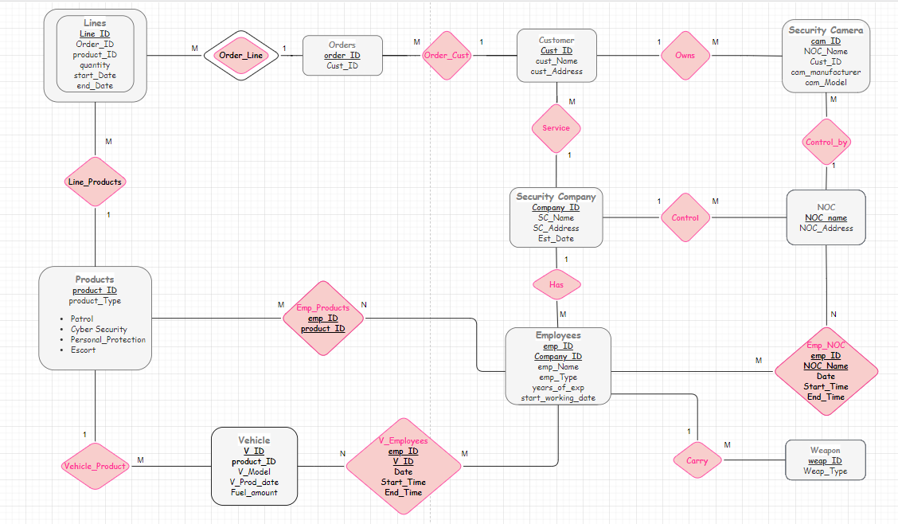
ERD

Slide 8
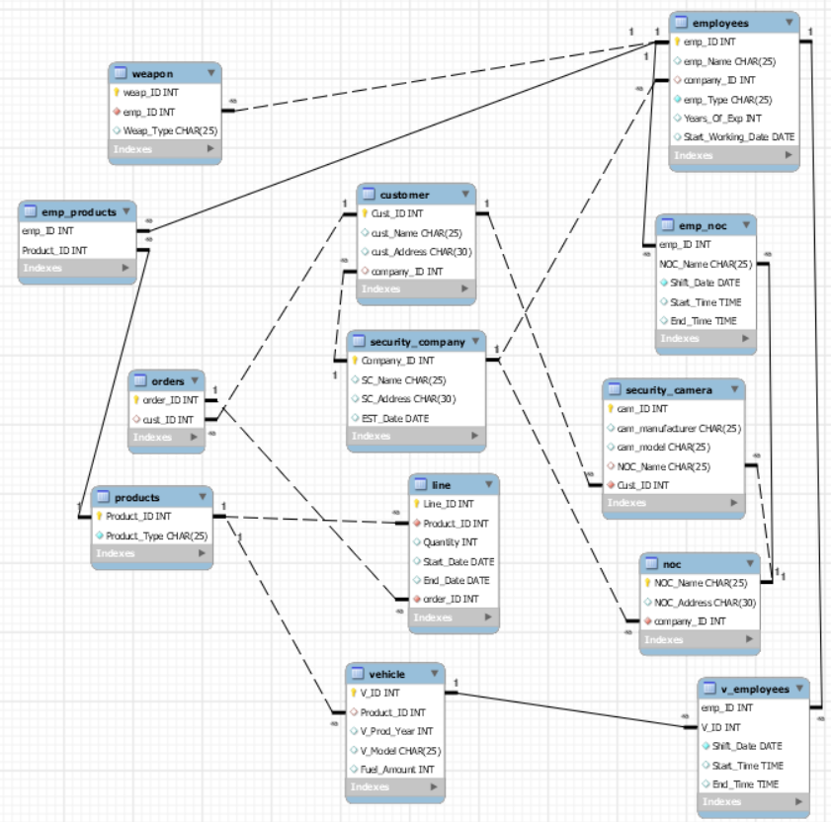
Physical
ERD

Slide 9
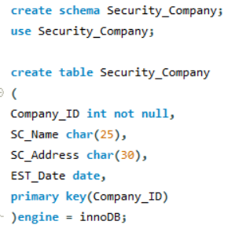
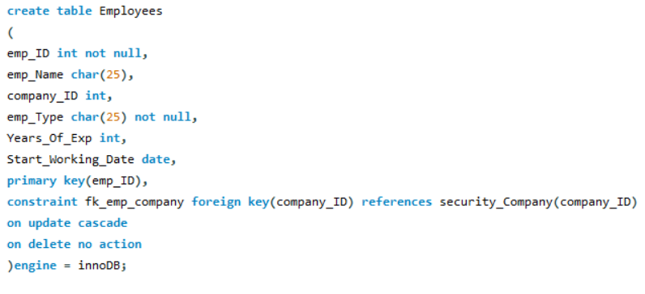
SQL code - creation

Slide 10
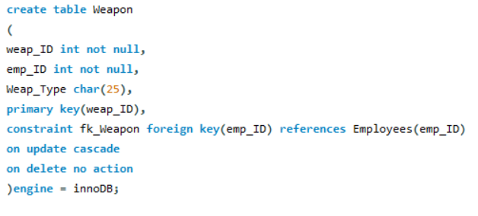
SQL code - creation

Slide 11
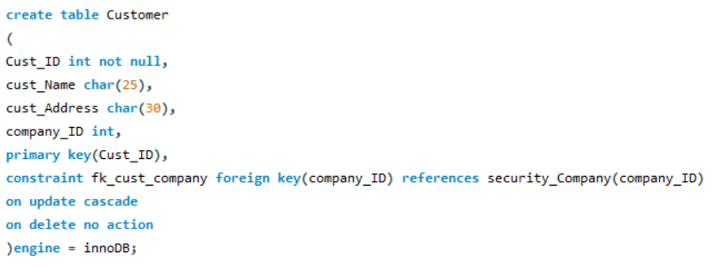
SQL code - creation

Slide 12
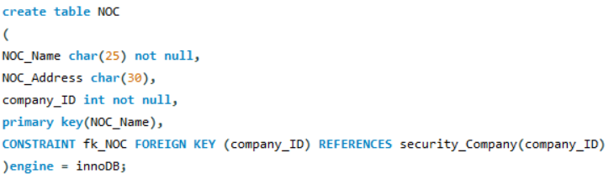
SQL code - creation

Slide 13
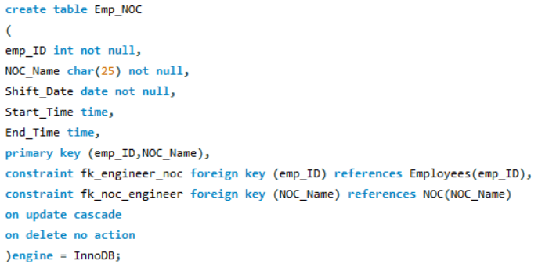
SQL code - creation

Slide 14
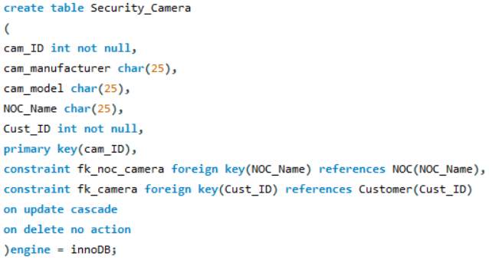
SQL code - creation

Slide 15
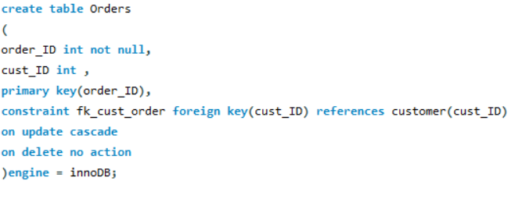
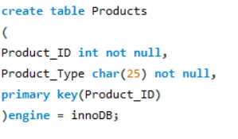
SQL code - creation

Slide 16
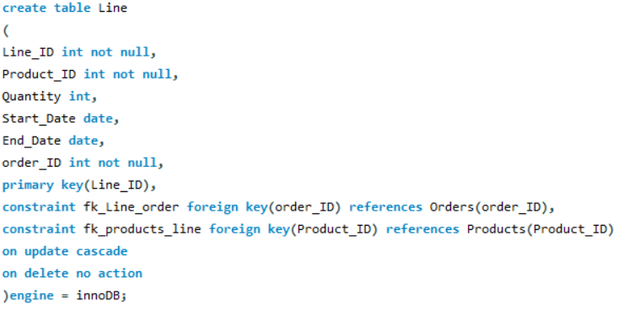
SQL code - creation

Slide 17
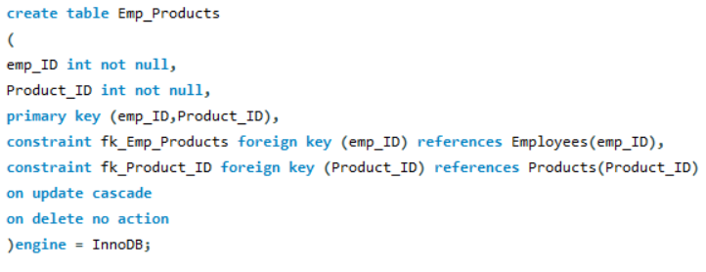
SQL code - creation

Slide 18
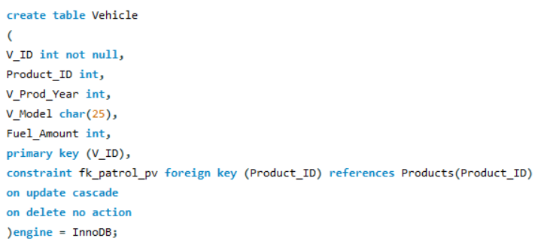
SQL code - creation

Slide 19
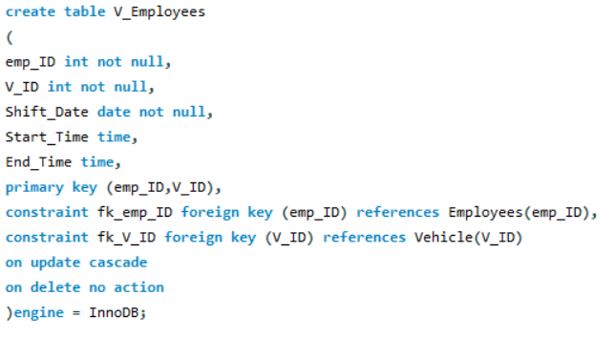
SQL code - creation

Slide 20


Customer Queries

Slide 21


Query
Get the customer id of all the customer in the company by address.
Solution
select cust_ID
from customer
order by cust_Address;
Querie
1
from
cust_ID
customer
Cust_Address
Order by

Slide 22
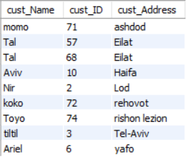
Solution- Querie 1

Slide 23

Query
Get the customers name that starts with the letter 'A'.
Solution
select cust_Name
from customer
where cust_Name like 'A%';
Querie
2
from
cust_Name
customer
cust_Name = %A
where

Slide 24

Query
Get the customer id and name that the camera id is between 80-83 and the customer id is smaller than 71.
Solution
select customer.cust_Name ,customer.cust_ID, security_camera.cam_ID
from customer, security_camera
where customer.cust_ID = security_camera.cust_ID
and cam_ID between 80 and 83 and security_camera.cust_ID > 71;
Querie
3
from
cust_ID, cust_Name,
cam_ID
Customer,
security_camera

Slide 25
Query
Get the customer id and name and order id that the customer order in bigger than 1 and the customer name is like aviv and momo.
Solution
select customer.cust_ID,customer.cust_Name, count(order_ID)
from customer, Orders
where Orders.cust_ID = customer.cust_ID
and order_ID in (select order_ID from Orders, customer where Orders.cust_ID = customer.cust_ID and
(cust_Name like ('Aviv') or cust_Name like (‘Momo')))
group by cust_ID, cust_Name
having count(order_ID)>1
order by cust_Name;
Querie
4

Slide 26
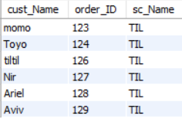
Solution-
Querie 4

Slide 27
Query
Get the customer name and order id and company that the customer order product.
Solution
Select customer.cust_Name, Orders.order_ID,
security_company.sc_Name
from customer,Orders,security_company
where customer.cust_ID = Orders.cust_ID
group by Orders.cust_ID
order by Orders.order_ID;
Querie
5

Slide 28
Query
Get customer name and camera id that the camera id equal to customer id and the camera id is between 50-70.
Solution
select customer.cust_Name, Security_Camera.cam_ID
from customer, Security_Camera
where customer.Cust_ID = Security_Camera.Cust_ID
and (Security_Camera.cam_ID) in (select cam_ID from Security_Camera where cam_ID between 50 and 70);
Querie
6

Slide 29
Query
Get security cameras id and manufactured by “sony” and the security cameras owned by the customer ‘Nir’
Solution
select distinct Security_Camera.cam_ID as ID,Security_Camera.cam_manufacturer as Manufacturer
from Security_Camera
where cam_ID in (select cam_ID from Security_Camera, customer where cust_Name = 'Nir' and customer.Cust_ID = Security_Camera.Cust_ID)
or cam_ID in (select cam_ID from Security_Camera, customer where cam_manufacturer = 'Sony' and customer.Cust_ID = Security_Camera.Cust_ID)
order by cam_manufacturer;
Querie
7

Slide 30
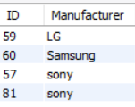
Solution-
Querie 7

Slide 31

Queries Employees

Slide 32

Query
Get employees data.
Solution
SELECT
Employees.*
FROM
Employees
ORDER BY DATEDIFF(Employees.Start_Working_Date, CURDATE()) DESC;
Querie
1

Slide 33

Query
Get the employee id from the employees that are officers.
Solution
SELECT
emp_ID
FROM
Employees
WHERE emp_Type = 'Officer';
Querie
2

Slide 34
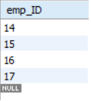
Solution-
Querie 2

Slide 35

Query
Get the details of the employees that worked for more than 10 years.
Solution
SELECT
Employees.*
FROM
Employees
WHERE YEAR(CURDATE()) - YEAR(Start_Working_Date) >= '10'ORDER BY Start_Working_Date ASC;
Querie
3

Slide 36

Query
Get the employees details and weapon id and name from employees and weapon table and show who doesn't owns a weapon.
Solution
SELECT
Employees.emp_ID, Employees.emp_Name, Employees.emp_Type, Weapon.weap_ID, Weapon.Weap_Type
FROM Employees
LEFT OUTER JOIN Weapon ON Employees.emp_ID = Weapon.emp_IDWHERE Weapon.weap_ID IS NULL;
Querie
4

Slide 37

Query
Show how many of weapon type are the same held by the employees.
Solution
SELECT
Employees.emp_Type, Weapon.Weap_Type, COUNT(Weapon.Weap_Type) AS 'number_Of_weapon’
FROM
Employees, WeaponWHERE Employees.emp_ID = Weapon.emp_IDGROUP BY Weapon.Weap_Type , Employees.emp_TypeORDER BY COUNT(Weapon.Weap_Type) DESC;
Querie
5

Slide 38
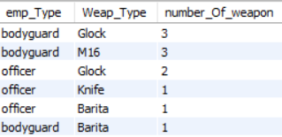
Solution-
Querie 5

Slide 39

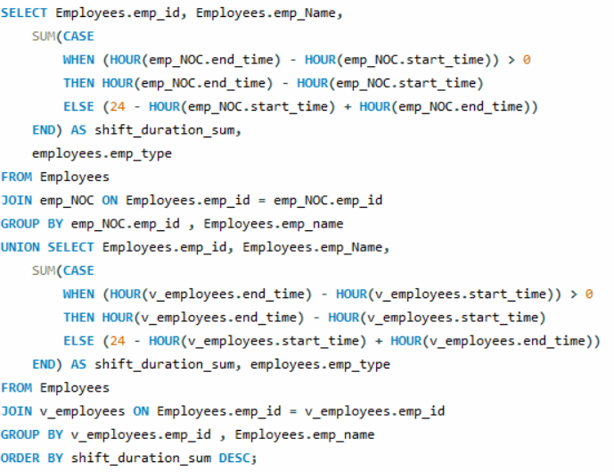
0
Query
Get the details of the "employee of the month" who worked the biggest amount of hours and show that amount of hours.
Solution
Querie
6

Slide 40
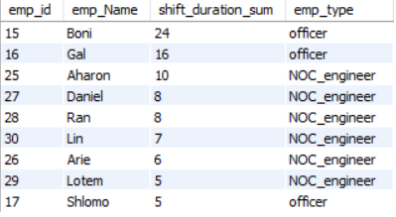
Solution-
Querie 6

Slide 41

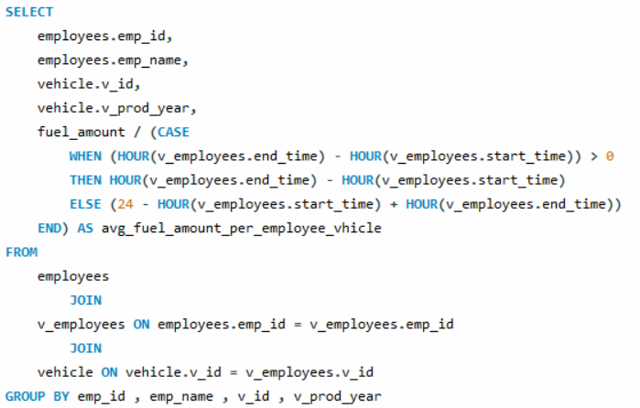
Query
Calculate the amount of fuel per hour to a vehicle.
Solution
Querie
7

Slide 42
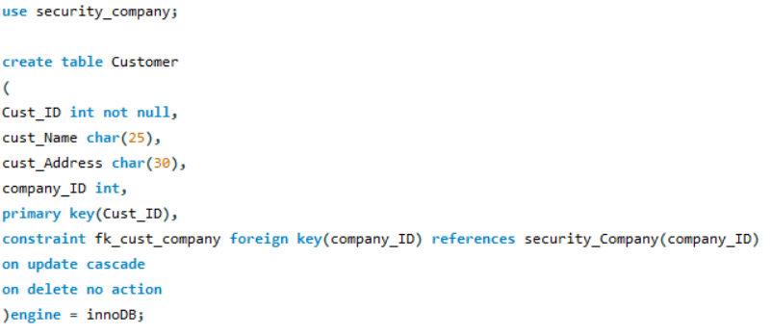
Triggers- customer table

Slide 43
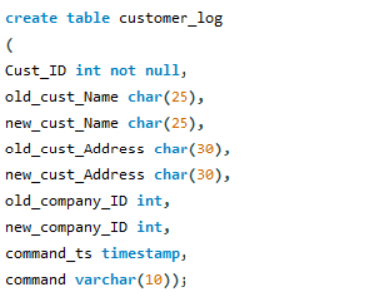
Triggers- Log table

Slide 44
delimiter $
CREATE TRIGGER Customer_customer_del_trg AFTER DELETE ON customer
FOR EACH ROW
BEGIN
INSERT INTO customer_log VALUES(old.Cust_ID, old.cust_Name, null, old.cust_Address,null, old.company_ID, null, now(), 'delete’);
END$
delimiter ;
Trigger
1

Slide 45
delimiter $
CREATE TRIGGER Customer_customer_upd_trg
AFTER UPDATE ON customer
FOR EACH ROW
BEGIN
INSERT INTO customer_log VALUES(new.Cust_ID, old.cust_Name, new.cust_Name, old.cust_Address, new.cust_Address, old.company_ID , new.company_ID, now(), 'update’);
END$
delimiter ;
Trigger
2

Slide 46
Thanks
For
Listening

